Slide 1
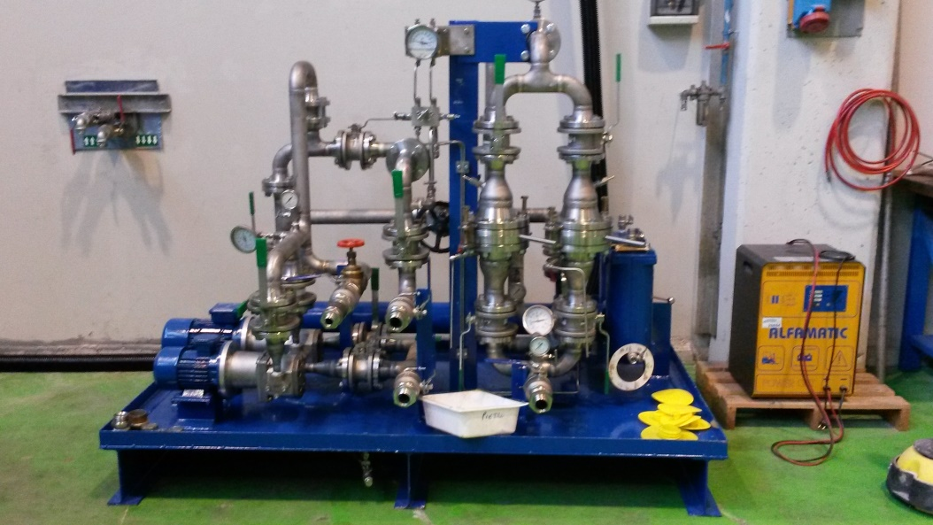
HS&E INCIDENT BULLETIN |  | 2nd half year 2017
Location Country: Italy | Type of incident : trauma for effort during assembly activities
Summary:
The episode happened during the travel from assembly to final check workshop; a contractor driver was handling (with a forklift truck) an oil console: at the entrance into the workshop, the load slipped from the forks (approximate height 20 cm) and overturned.
Root Causes: | Actions Taken Thus Far: Next Steps
load instability during handling activities with forklift (missing check of the barycenter); failure to use of extension forks, suitable for bulky loads handling; slight difference in height between workshop floor and paving that has increased the unbalance of the load | Replacement of a damaged pressure indicator; regular use of suitable equipment for each mechanical handling; systematic check of loads weight and barycenter before starting mechanical handling; organize a training, involving handling operators, reviewing the right procedures of load harness and the handling activities incidents recorded in the last years.

